Slide 1


SAP Cloud Integration
Training
ON THE
SAP BUSINESS TECHNOLOGY PLATFORM
Date: Jan 20th, 2023
Time: 9:00AM IST
Facilitator: Anu
www.anubhavtrainings.com

Slide 2
Agenda
Mapping
Converter
CSV to XML converter
Live example of postman to CPI using CSV to XMLconverter

Slide 3
Adapters
Connects SAP Cloud Integration to Sender or Receiver
HTTPS:
Establishes an HTTPS connection between SAP Cloud Integration and a sender system.

Slide 4
HTTP ADAPTER
Parameters of the HTTPS Sender Adapter
Parameter | Description
Address | Enter the URL of the HTTP system to connect to.
Authorization | Specifies the authorization option for the sender.
CSRF Protected | This option prevents Cross-Site Request Forgery (CSRF), which is a malicious online attack. Such attacks exposes user content without their authorization.
CamelHttpUrl
Refers to the complete URL called, without query parameters.
For example, CamelHttpUrl=https://test.bsn.neo.ondemand.com/http/hello.

Slide 5
Postman CPI Integration
Postman
CPI

Slide 6
POSTMAN CPI integration
Things required
End point URL
CPI User id and password

Slide 7
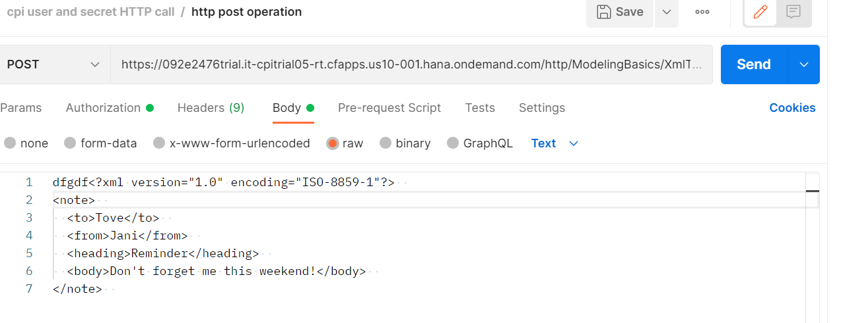
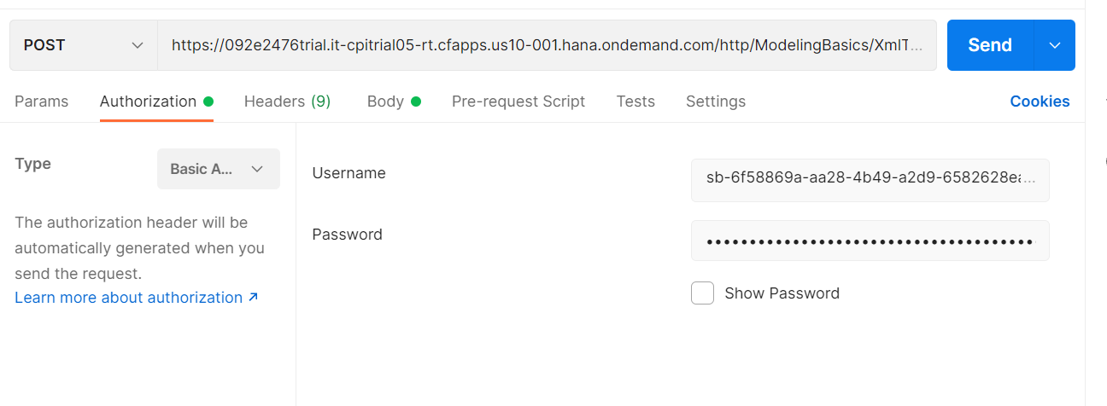
POSTMAN CPI INtegration

Slide 8
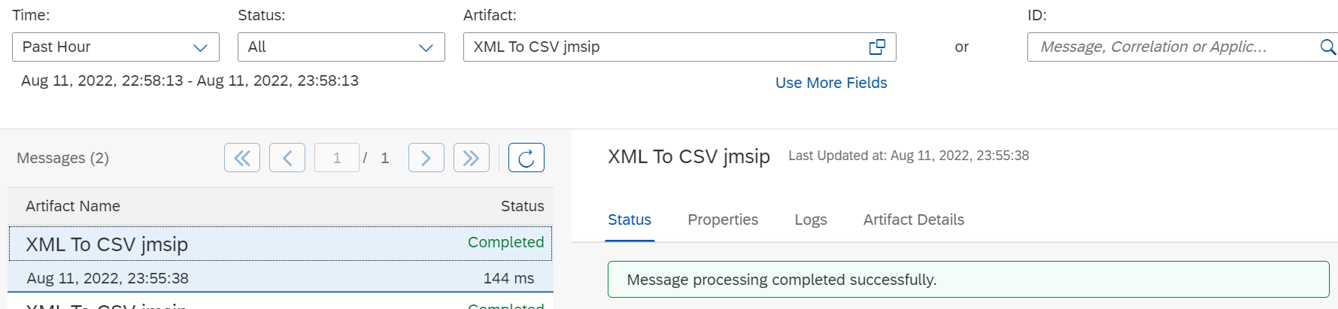
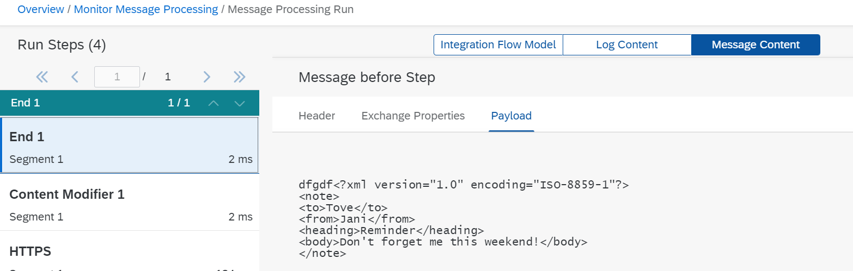
POSTMAN CPI INtegration

Slide 9
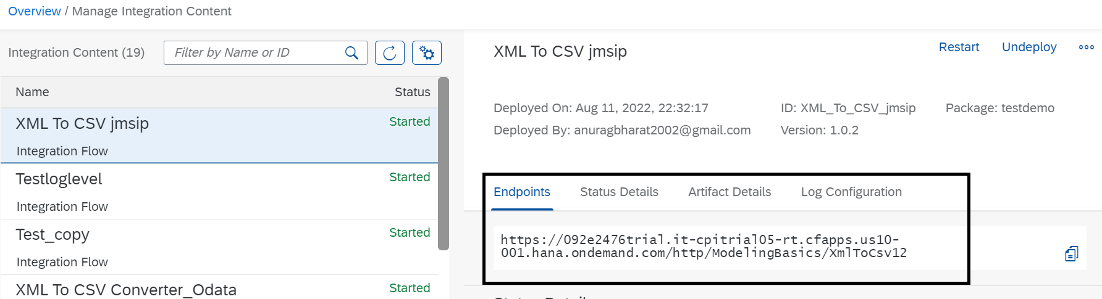
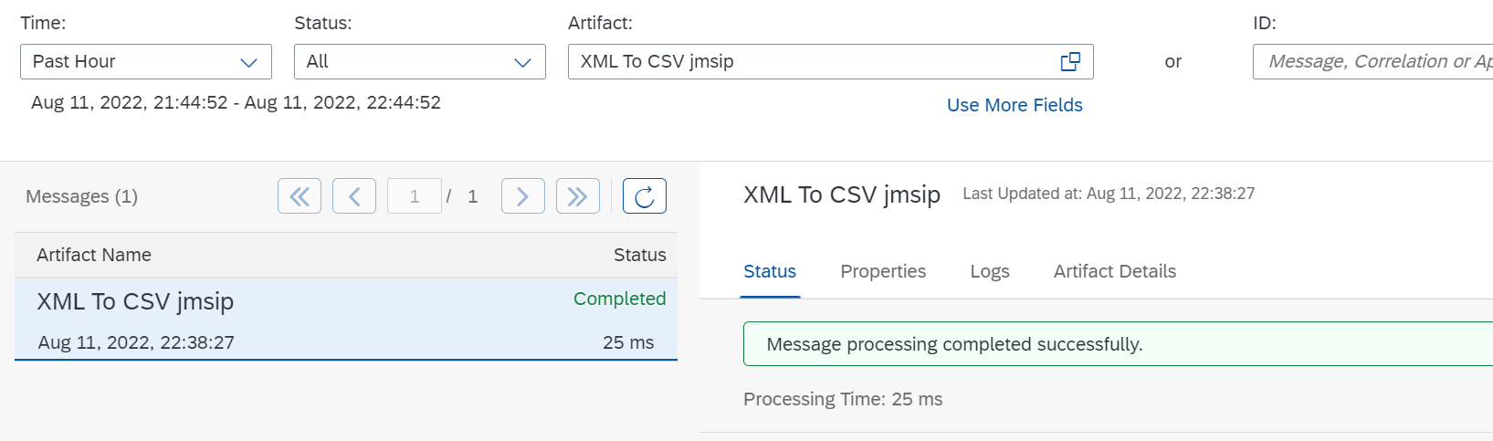
POSTMAN CPI Integration

Slide 10
CSV to XML Converter
Procedure
In the palette, choose , then navigate to Converter CSV to XML Converter.
Place the CSV to XML converter shape in the integration process and define the message path.

Slide 11
Choose CSV to XML Converter and provide values in fields based on description in table.

Slide 12
Field | Description
XML Schema | Choose Browse. Select the XML schema you want to use. Optionally, you can also upload the XML schema from your local file system by choosing Upload from File System.
Path to Target Element in XSD | XPath in the XML schema file where you want to place the content from CSV file.
Record Marker in CSV | The record in CSV file that indicates the entry that the converter has to consider as the starting point of the content. Note If you don’t provide a value for this field, the converter considers all the records in the CSV file for conversion.
Field Separator in CSV | Select the character from dropdown list that is used as the field separator in CSV file. Tip If you want to use a field separator that isn’t available in the dropdown list, manually enter the character.
Exclude First Line Header | Select this checkbox if you want to use the header information from the first line of CSV file to map the column to the corresponding xsd attributes.Note If you don't select the checkbox, then the converter maps the attributes of the CSV file to the order of occurrence in the XSD. To use this option, the CSV and XSD must share the same header-attribute names. If the header names don't match or the same header name is used multiple times in the first line of the CSV, it leads to ambiguity that the converter can resolve as it's an unsupported XML specification.
Choose CSV to XML Converter and provide values in fields based on description in table

Slide 14
Schema
<?xml version="1.0" encoding="UTF-8" standalone="yes"?><xs:schema attributeFormDefault="unqualified" elementFormDefault="qualified" xmlns:xs="http://www.w3.org/2001/XMLSchema"> <xs:element name="Products"> <xs:complexType> <xs:sequence> <xs:element minOccurs="1" maxOccurs="unbounded" name="Product"> <xs:complexType> <xs:sequence> <xs:element nillable="false" maxOccurs="1" name="ProductId"> <xs:simpleType> <xs:restriction base="xs:string" xmlns=""> <xs:maxLength value="10"/> </xs:restriction> </xs:simpleType> </xs:element> <xs:element type="xs:string" nillable="true" minOccurs="0" maxOccurs="1" name="Name" xmlns=""/> <xs:element nillable="true" minOccurs="0" maxOccurs="1" name="Category"> <xs:simpleType> <xs:restriction base="xs:string" xmlns=""> <xs:maxLength value="40"/> </xs:restriction> </xs:simpleType> </xs:element> <xs:element nillable="true" minOccurs="0" maxOccurs="1" name="DimensionUnit"> <xs:simpleType> <xs:restriction base="xs:string" xmlns=""> <xs:maxLength value="3"/> </xs:restriction> </xs:simpleType> </xs:element> <xs:element type="xs:decimal" nillable="true" minOccurs="0" maxOccurs="1" name="DimensionDepth" xmlns=""/> <xs:element type="xs:decimal" nillable="true" minOccurs="0" maxOccurs="1" name="DimensionHeight" xmlns=""/> <xs:element type="xs:decimal" nillable="true" minOccurs="0" maxOccurs="1" name="DimensionWidth" xmlns=""/> <xs:element type="xs:decimal" nillable="true" minOccurs="0" maxOccurs="1" name="Weight" xmlns=""/> <xs:element nillable="true" minOccurs="0" maxOccurs="1" name="WeightUnit"> <xs:simpleType> <xs:restriction base="xs:string" xmlns=""> <xs:maxLength value="3"/> </xs:restriction> </xs:simpleType> </xs:element> </xs:sequence> </xs:complexType> </xs:element> </xs:sequence> </xs:complexType> </xs:element></xs:schema>

Slide 18
XML to CSV Converter
Procedure
In the palette, choose , then Converter XML to CSV Converter.
Place the XML to CSV converter in the integration process and define the message path.

Slide 19
Field | Description
Path to Source Element in XSD | Path to the source element in the XSD file
Field Separator in CSV | Select the character that you want to use as the field separator in CSV file from dropdown list Tip If you want to use a field separator that is not available in the dropdown list, manually enter the character.
Include Field Name as Headers | Select this checkbox if you want to use the field names as the headers in CSV file
Include Parent Element | Select this checkbox if you want to include the parent element of the XML file in CSV file
Include Attribute Values | Select this checkbox if you want to include attribute values in the CSV file
Choose XML to CSV Converter and provide values in fields based on description in table

Slide 20
Json to XML converter
The JSON to XML converter enables you to transform messages in JSON format to XML format.
Procedure
In the palette, choose , then choose Transformation Converter JSON to XML Converter.
Insert the converter at the desired position in your integration process. The converter appears as a graphical element in your integration process.
The properties tab page for the XML to JSON Converter opens.

Slide 21
Json to XML converter
Tab | Option | Description
General | Name | Enter the name of the converter.
Processing | JSON Prefix (only if the option Use Namespace Mapping is selected) | Enter the mapping of the JSON prefix to the XML namespace. The JSON namespace/prefix must begin with a letter and can contain aA-zZ and 0-9.
 | JSON Prefix Separator | Enter the JSON prefix separator to be used to separate the JSON prefix from the local part. The value used must not be used in the JSON prefix or local name. The following characters are allowed: colon(:), comma(,), dot(.), pipe(|), semicolon(;), and space.
 | Add XML Root Element | Select this option to convert JSON documents with an XML root element
 | Name (only if the option Add XML Root Element is selected) | Enter the name of the XML root element. The name must comply with the NCName rules: The name must begin with a letter or an underscore. The valid characters for the remainder of the name are: Letters Digits Period Hyphen Underscore
 | Namespace Mapping (only if the option Add XML Root Element is selected) | Enter the namespace of the XML root element that you have configured in the integration flow.
Define the parameters for your conversion, see table below

Slide 22
XML to JSON Converter
Procedure
In the palette, choose  Transformation Converter XML to JSON Converter.Your cusor symbol
Insert the converter at the desired position in your integration process.The converter appears as a graphical element in your integration process.
The properties tab page for the XML to JSON-Converter opens

Slide 23
Option | Description
Name | Enter the name of the converter.
JSON Output Encoding | Enter the JSON output encoding. The default value is from header or property. If you select from header or property, the converter tries to read the encoding from the message header or exchange property CamelCharsetName. If there is no value defined, UTF-8 is used.
XML Namespace (only if the option Namespace Mapping is selected) | If you select from header or property, the converter tries to read the encoding from the message header or exchange property CamelCharsetName. If there is no value defined, UTF-8 is used.
JSON Prefix Separator (only if the option Namespace Mapping is selected) | Enter the JSON prefix separator to be used to separate the JSON prefix from the local part. The value used must not be used in the JSON prefix or local name. The following characters are allowed: colon(:), comma(,), dot(.), pipe(|), semicolon(;), and space.
Suppress JSON Root Element | Choose this option to create the JSON message without the root element tag.
Define the parameters for your conversion, see table below

Slide 24
Q n A

Slide 25
Thank You

